Slide 1



Slide 2
Vocabulary of the Day:
Ransacked (Verb) –: Go hurriedly through (a place) stealing things and causing damage.
Reviled (Verb) –: criticize in an abusive or angrily insulting manner
Nudged (Verb) –: touch or push (something) gently or gradually.
Congregated (Verb) – gather into a crowd or mass.
Appease (Verb) - to calm, satisfy

Slide 3
What is sentence Completion?
There are questions in Verbal Ability section of placement papers that require the students to fill in the gaps with appropriate words. This is referred to as Sentence Completion.

Slide 4
Question 1
The Sentence Completion questions check _______
a) understanding of vocabulary b) understanding of logical structure of sentence c) both a & b d) neither a nor b

Slide 5
Question 1
The Sentence Completion questions check _______
a) understanding of vocabulary b) understanding of logical structure of sentence c) both a & b d) neither a nor b

Slide 6
Types of Questions
Single Blank
Cloze Test
Double Blank

Slide 7
Single Blank Question
The one-blank Sentence Completions are solved in two steps:
Step 1: define the blank. Use context clues in the sentence to figure out what kind of word will go in the blank.
Step 2: match the answer. Look down the list of answer choices and pick the one that best matches your word for the blank. Then be sure to read the answer choice back into the sentence to be sure it makes sense.

Slide 8
Example
'Thanks to her sunny demeanor and --------------- attitude, Gertrude was always a welcome guest.'
(A) Fatigued
(B) Redundant
(C) Ambitious
(D) Contradictory
(E) Light-hearted
In this sentence, we're looking for a word that has something to do with being cheerful. Fatigued means 'tired,' which doesn't fit. Redundant means 'saying the same thing twice,' which also doesn't work. Ambitious means 'striving for success,' which is positive, but doesn't match the clue ‘sunny demeanor’, and contradictory also doesn't fit. Light-hearted means 'happy' or 'cheerful.' If you read it back into the sentence, it fits. So, the correct answer is (E).

Slide 9
Question 2
A child should not be ______ as being either very shy or overaggressive.
categorized
instructed
intoned
distracted
refrained

Slide 10
Question 2
A child should not be ______ as being either very shy or overaggressive.
categorized
instructed
intoned
distracted
refrained

Slide 11
Double Blank Question
The double blank questions are worked out in two steps:
Step 1: define the blanks. Use context clues in the sentence to figure out what the words in the blanks will mean.
Step 2: match your answer. Pick the answer that provides the word you need for both blanks.
With two-blanks, you get two chances to eliminate each answer. Remember that both words have to match; if even one is wrong, you can confidently eliminate the whole answer without even knowing the other.
This makes two-blank sentence completions a lot more forgiving if your vocabulary isn't quite where you'd like it to be.

Slide 12
Example
'Despite his reputation for --------------- and carelessness in his academic work, Alexander was always very --------------- when working on his personal projects.'
(A) Intransigence…punctual
(B) Contrition…tactful
(C) Negligence…meticulous
(D) Haste…hapless
(E) Penury…conscientious
Let's go through the answers one by one. In choice (A), intransigence means 'stubbornness.' It doesn't fit with the idea of carelessness or laziness, so you can cross off (A) right away. Moving on to (B), contrition means 'being sorry about something.' That also doesn't work with carelessness, so (B) is out. In choice (C), negligence is 'carelessness' - think of the same root word in 'neglect.' And meticulous means that you 'pay attention to the details,' which seems to fit with the second word as well. So, this one may fit. In choice (D), haste might work for the first blank, but hapless doesn't fit the second blank at all; it means 'unlucky,' which has nothing to do with being careful. Again, if it's half wrong, it's all wrong, so get rid of it. In (E), penury lets you eliminate the answer right away; this means 'poverty,' which doesn't fit the clue. So (C) is the only answer choice left. Read it back into the sentence to double-check

Slide 13
Question 3
President Anwar el - Sadat of Egypt, disregarding ______ criticism in the Alab world and in his own Government, ______ accepted prime minister Menahem Begin's invitation to visit Israel in order to address the Israeli parliament.
acrimonious - formally
blemished - stiffly
categorical - previously
malignant - plaintively
charismatic - meticulously

Slide 14
Question 3
President Anwar el - Sadat of Egypt, disregarding ______ criticism in the Alab world and in his own Government, ______ accepted prime minister Menahem Begin's invitation to visit Israel in order to address the Israeli parliament.
acrimonious - formally
blemished - stiffly
categorical - previously
malignant - plaintively
charismatic - meticulously

Slide 15
Cloze Test Questions
A Cloze test is an exercise where the candidate is provided with a paragraph. The paragraph has missing words or blanks which have to be filled by the candidate from the options given.
Use contextual clues to determine missing words
Check the sentence flow

Slide 16
Question 4
Petroleum, or crude oil, is one of the world's (1) ----- natural resources. Plastics, synthetic fibres, and (2) ----- chemicals are produced from petroleum. It is also used to make lubricants and waxes. (3) ----- , its most important use is as a fuel for heating, for (4) -- --- electricity, and (5) ----- for powering vehicles.
1. A. as important/ B. most important/ C. so importantly/ D. less importantly/ E. too important
2. A. much/ B. a lot/ C. plenty/ D. many/ E. less
3. A. Therefore/ B. However/ C. Moreover/ D. Hence/ E. Rather
4. A. generated/ B. to generate/ C. being generated/ D. generate/ E. generating
5. A. decisively/ B. exclusively/ C. especially/ D. favourably/ E. notably

Slide 17
Question 4
Petroleum, or crude oil, is one of the world's (1) ----- natural resources. Plastics, synthetic fibres, and (2) ----- chemicals are produced from petroleum. It is also used to make lubricants and waxes. (3) ----- , its most important use is as a fuel for heating, for (4) -- --- electricity, and (5) ----- for powering vehicles.
1. A. as important/ B. most important/ C. so importantly/ D. less importantly/ E. too important
2. A. much/ B. a lot/ C. plenty/ D. many/ E. less
3. A. Therefore/ B. However/ C. Moreover/ D. Hence/ E. Rather
4. A. generated/ B. to generate/ C. being generated/ D. generate/ E. generating
5. A. decisively/ B. exclusively/ C. especially/ D. favourably/ E. notably

Slide 18
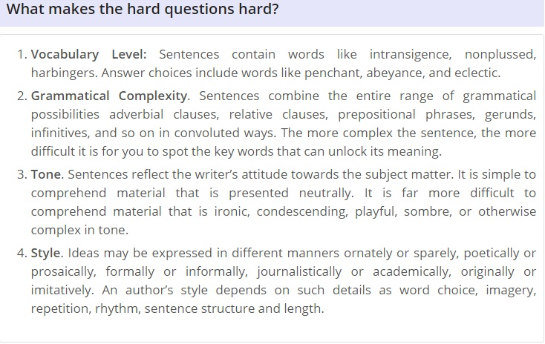

Slide 19
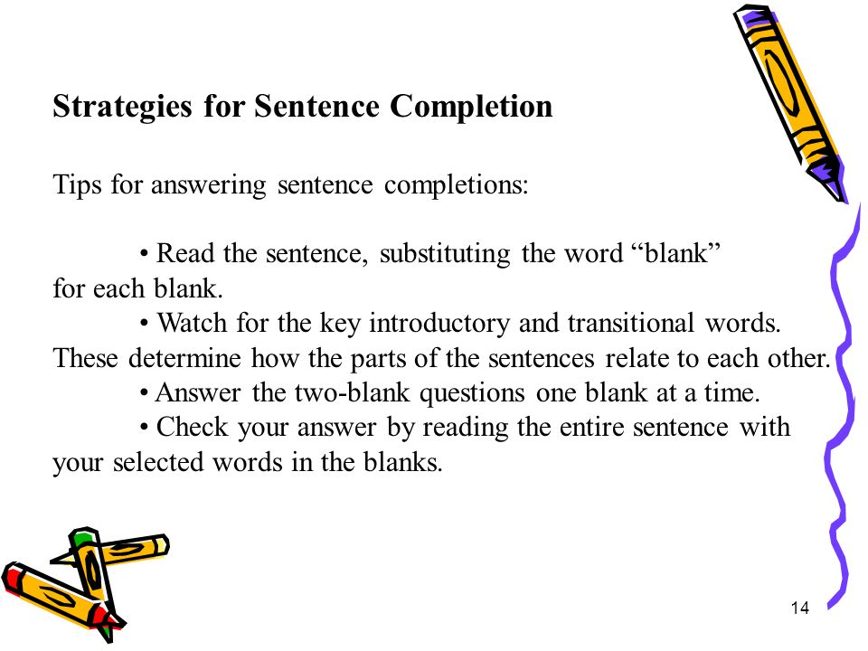

Slide 20
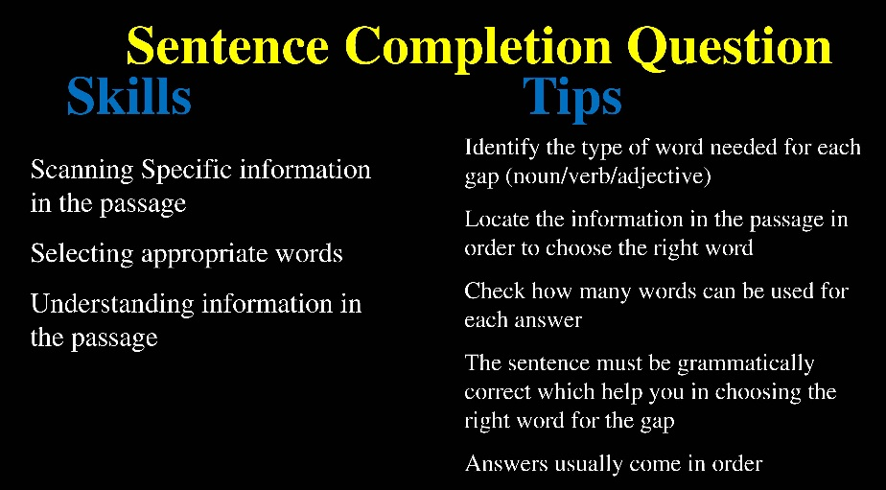

Slide 21
Question 5
When approaching a sentence completion sentence, look for signal words to get an idea about the sentence
a) True b) False

Slide 22
Question 5
When approaching a sentence completion sentence, look for signal words to get an idea about the sentence
a) True b) False

Slide 23
Question 6
When solving sentence completion questions, which punctuation marks help in solving the questions?
a) Comma b) Semicolon
c) Colon
d) All of the above
e) None of the above

Slide 24
Question 6
When solving sentence completion questions, which punctuation marks help in solving the questions?
a) Comma b) Semicolon
c) Colon
d) All of the above
e) None of the above

Slide 25
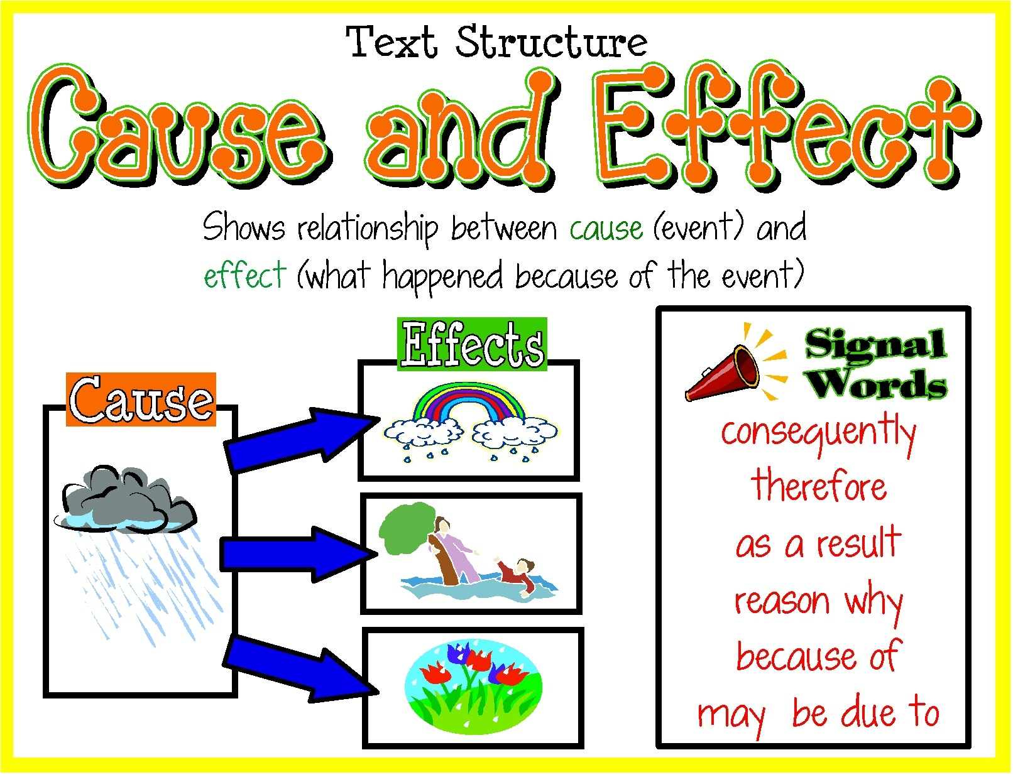

Slide 26
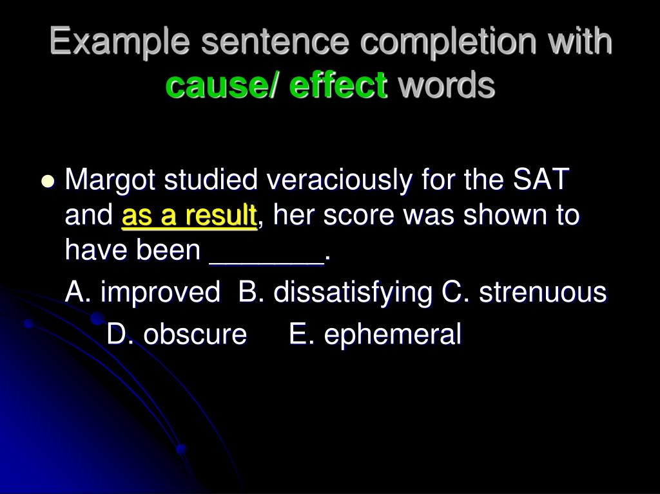

Slide 27
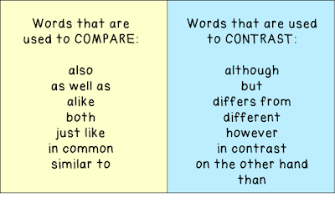

Slide 28
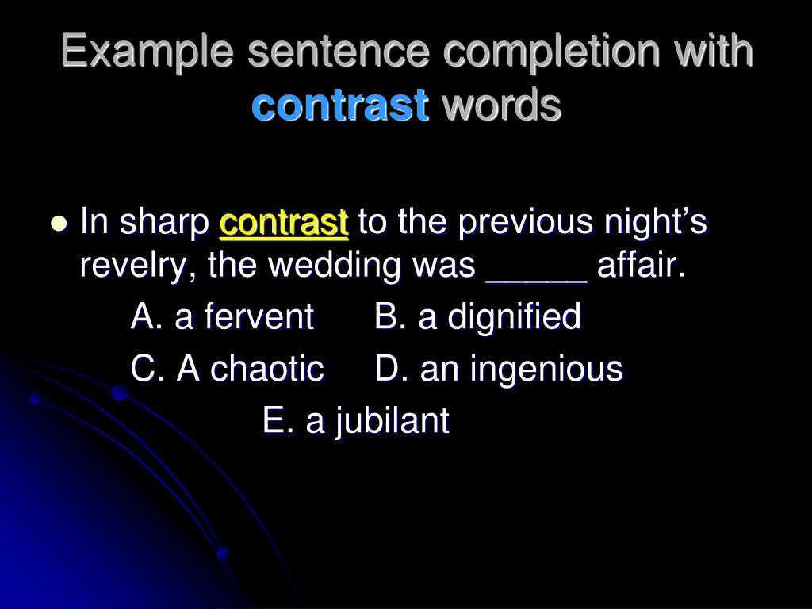

Slide 29
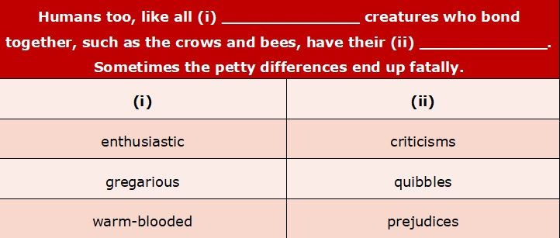

Slide 30
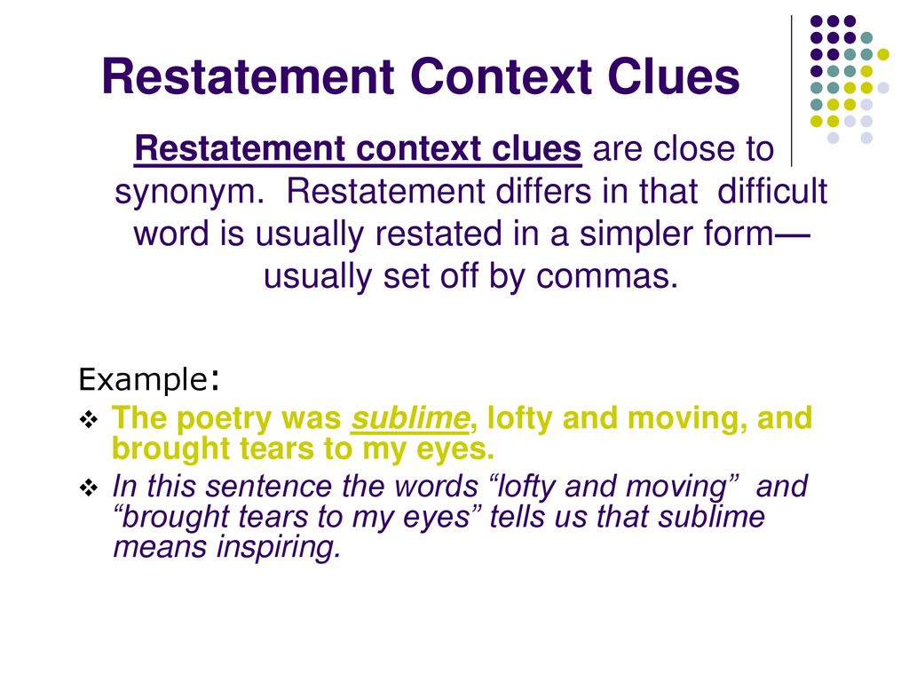

Slide 31
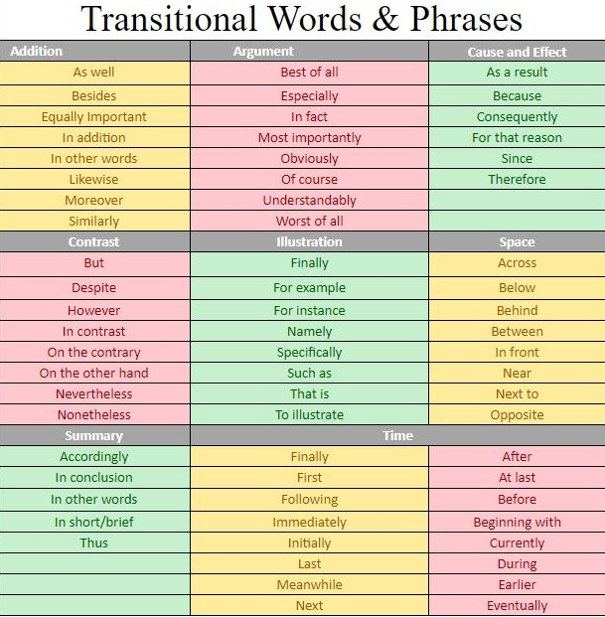

Slide 32


Slide 33
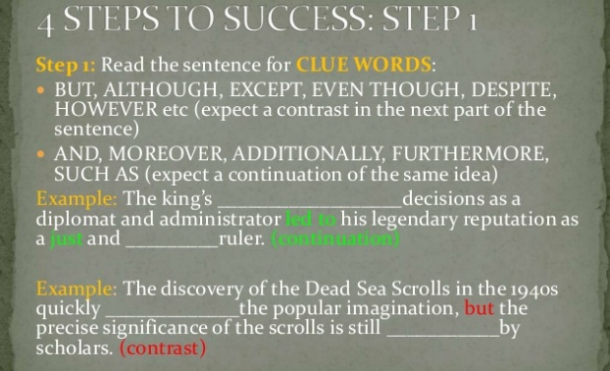

Slide 34
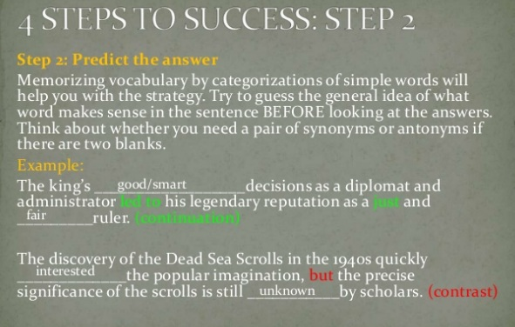

Slide 35
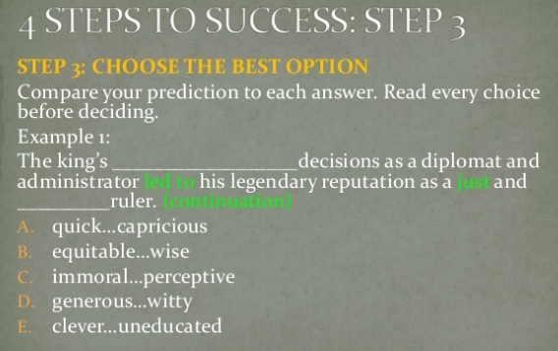

Slide 36
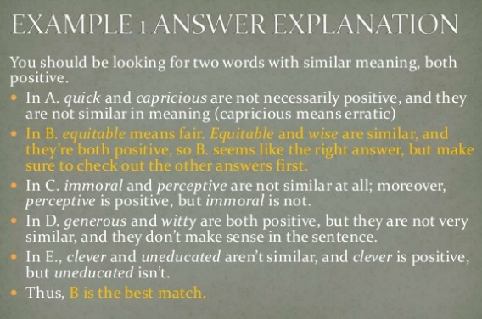

Slide 37
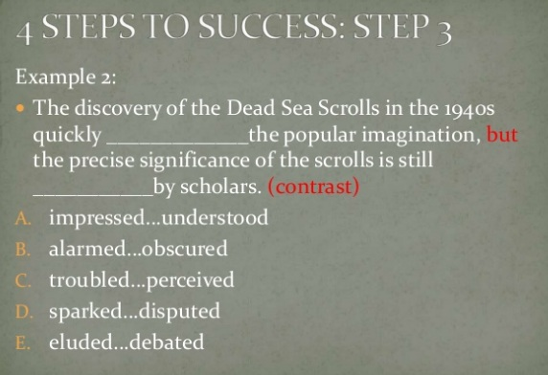

Slide 38
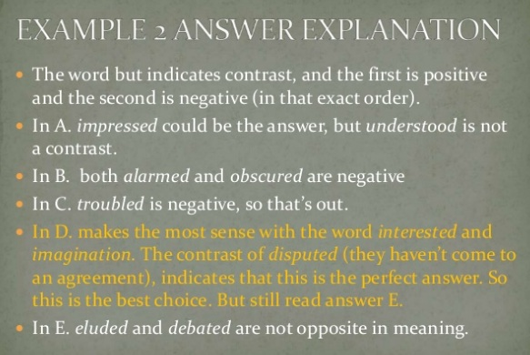

Slide 39
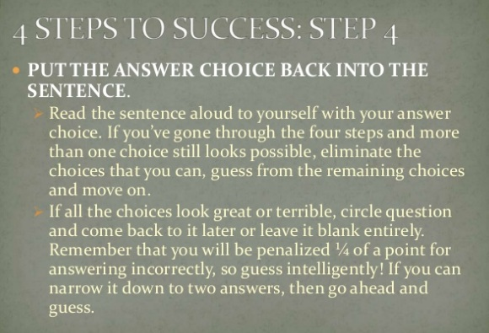

Slide 40
Few Strategies
break the sentence down into the main clause and introductory clause or phrase in order to identify the relationship it expresses.

Slide 41
Example
In a hospital setting, hand washing is primarily a ____________ measure. A) prophylactic B) pseudocyetic C) protensive D) propaedeutic E) otiose
SOLUTION
The main clause declares that hand washing is primarily a measure. However, preceding the declaration is a condition or constraint expressed in an introductory phrase, “a hospital setting.” This phrase sets the contextual field within which the main clause is to be understood. If you generalize from your knowledge, it would seem that any measure promoted in a hospital should result in good health. Only one of the answers would result in this. That is answer (A) in which prophylactic means “prevents disease.”

Slide 42
Few Strategies
attend to sets, whether a set of synonyms or antonyms or special word groups.

Slide 43
Example
Even when a ___________ mother was made available to the infant chimpanzee, the infant detected the __________________ and reacted with high anxiety.
A) hedonistic…contrivance B) vagrant…apostasy C) veteran…ruse D) pretender…interference E) surrogate…substitution
SOLUTION
Nothing in a common sense association supports the pairing of hedonistic and contrivance, vagrant and apostasy, veteran and ruse, or pretender and interference. The only set of related words is surrogate (meaning substitute) and substitution in (E), the correct answer.

Slide 44
Few Strategies
Pay attention to the words that control the figurative field of the sentence.

Slide 45
Example
In seventeenth-century France, private and public opinion portrayed the physician as a vulture of greed, circling the sick and dying, battening off the suffering of the afflicted, and ___________________ the remains of his prey. A) spending B) devouring C) retreating from D) decrying E) resorbing
SOLUTION
Clearly the correct answer is (B), devouring. The key words that control the figurative field are vulture, circling, and battening. Read the items carefully and make sure that the completed sentence is meaningful, that it makes sense. Sometimes two or three choices will seem to satisfy the necessity for meaning-based completions, but only one will ever complete the sentence meaningfully.

Slide 46


Slide 47
Read the entire sentence before trying to pick any answers!
Before reading the answer choices, consider what word(s) you would put in the blank(s) and use that as a guide to assess answer choices.
Consider word valence—whether a positive or negative word belongs in a given blank.
Identify signal words and phrases—primarily transitions—that help indicate the overall structure of ideas in the sentence/mini-passage.
Whenever you guess, eliminate as many wrong answers as you can first.
Once you’ve chosen words for multi-blank questions, read through the entire passage with your word choices to make sure the entire thing makes sense all together.
Remember that every text completion question is worth the same amount of points! So don’t get overly bogged down on multi-blank questions when there are still simpler ones to complete.

Slide 48
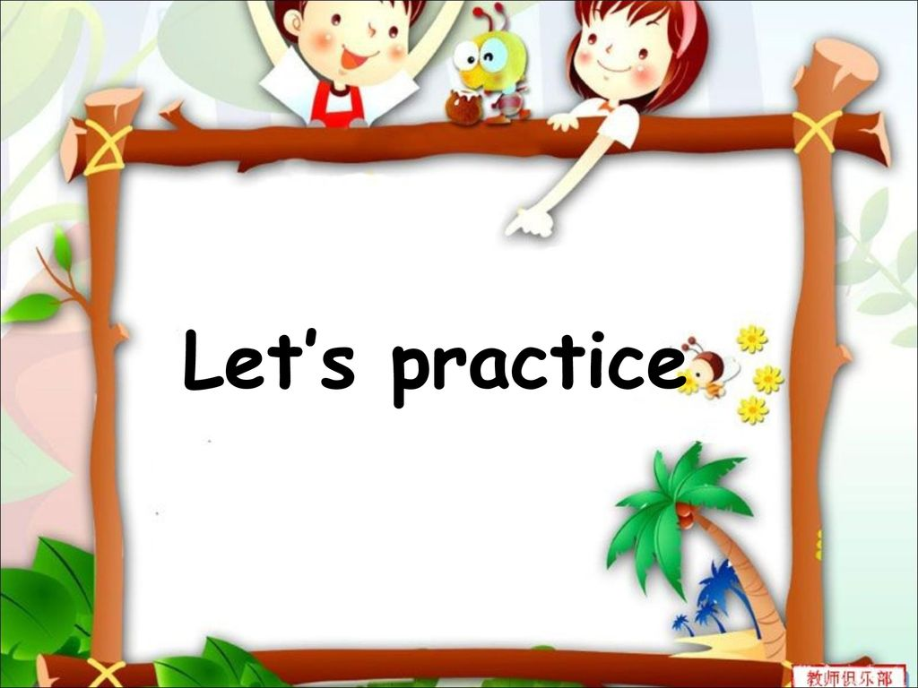

Slide 49
Practice 1
The path to ___________ is a path of hardship.
a. Workmanship
b. Successful
c. Illumination
d. Enlightenment

Slide 50
Practice 1
The path to ___________ is a path of hardship.
a. Workmanship
b. Successful
c. Illumination
d. Enlightenment

Slide 51
Practice 2
You seem to have ____________ done this. There is no way the vase could have otherwise fallen from here.
a. Architecturally
b. Décor-wise
c. Deliberately

Slide 52
Practice 2
You seem to have ____________ done this. There is no way the vase could have otherwise fallen from here.
a. Architecturally
b. Décor-wise
c. Deliberately

Slide 53
Practice 3
The sign-post is so _________. If only the ones who erected it had some literary sense!
a. Shakespearian
b. Poetic
c. Ambiguous
d. Ambivalence

Slide 54
Practice 3
The sign-post is so _________. If only the ones who erected it had some literary sense!
a. Shakespearian
b. Poetic
c. Ambiguous
d. Ambivalence

Slide 55
Practice 4
Jackson’s performance was ________________. People even fainted.
a. Overcrowding
b. Overwhelming
c. Outstanding

Slide 56
Practice 4
Jackson’s performance was ________________. People even fainted.
a. Overcrowding
b. Overwhelming
c. Outstanding

Slide 57
Practice 5
I kept feeling guilty that I had disturbed him. But contrary to my fear, I found that he was __________ !
a. Unfazed
b. Innocent
c. Overwhelmed
d. Imprisoned

Slide 58
Practice 5
I kept feeling guilty that I had disturbed him. But contrary to my fear, I found that he was __________ !
a. Unfazed
b. Innocent
c. Overwhelmed
d. Imprisoned

Slide 59
Practice 6
He is a silent social worker; and prefers to hide his _________ tendencies from shrewd colleagues at work.
a. Societal
b. Philatelist
c. Philanthropist
d. Partying

Slide 60
Practice 6
He is a silent social worker; and prefers to hide his _________ tendencies from shrewd colleagues at work.
a. Societal
b. Philatelist
c. Philanthropist
d. Partying

Slide 61
Practice 7
She likes to work in _____________ projects. We knew she was versatile.
a. Multi-utility
b. Vivacious
c. Multi-disciplinary
d. Stylish

Slide 62
Practice 7
She likes to work in _____________ projects. We knew she was versatile.
a. Multi-utility
b. Vivacious
c. Multi-disciplinary
d. Stylish

Slide 63
Practice 8
Sarita has been talking to me since morning. Not only do I find her attitudinal change ______, I even find it somewhat _______.
a. Surprising, intriguing
b. Interesting, boring
c. Shocking, surprising

Slide 64
Practice 8
Sarita has been talking to me since morning. Not only do I find her attitudinal change ______, I even find it somewhat _______.
a. Surprising, intriguing
b. Interesting, boring
c. Shocking, surprising

Slide 65
Practice 9
The Shimla trip was fantastic. Not only did the tour bring me a ______, but it almost sent me into ________ world.
a. Freshening, mundane
b. Holiday, international
c. Enjoyment, another
d. Change, another

Slide 66
Practice 9
The Shimla trip was fantastic. Not only did the tour bring me a ______, but it almost sent me into ________ world.
a. Freshening, mundane
b. Holiday, international
c. Enjoyment, another
d. Change, another

Slide 67
Practice 10
Your noise, children, is not just _______; it is an absolute ________.
a. Sweet, honey-like
b. Sweet, sugar-cube
c. Commotion, chaos
d. Commodity, chaotic

Slide 68
Practice 10
Your noise, children, is not just _______; it is an absolute ________.
a. Sweet, honey-like
b. Sweet, sugar-cube
c. Commotion, chaos
d. Commodity, chaotic

Slide 69
